Slide 1
Bo-ecli
Athens, June 8th & 9th

Slide 2
DOCUMENTATION CENTRE FOR THE JUDICIARY. Spanish council

Slide 3
ECLI – CENDOJ
2013
2014
2014
ECLI IMPLEMENTATION
DELIVERY SITEMAP FILES TO DG JUSTICE
PROMOTING ECLI
BIG DATA ANALYTICS

Slide 4
ECLI IMPLEMENTATION
Auto de 26 de abril de 2011, del Tribunal Supremo. Sala de lo Contencioso, con
ROJ: ATS 3837/2011
ECLI:ES:TS:2011:3837A
Sentencia del 29 de mayo de 2011, de la Audiencia Provincial de Zaragoza, con
ROJ: SAP Z 160/2011
ECLI:ES:AP Z:2011:160
UNIQUE & OFFICIAL
EASY TO REMEMBER
EASY TO USE
6.000.000 of ECLI’S

Slide 5
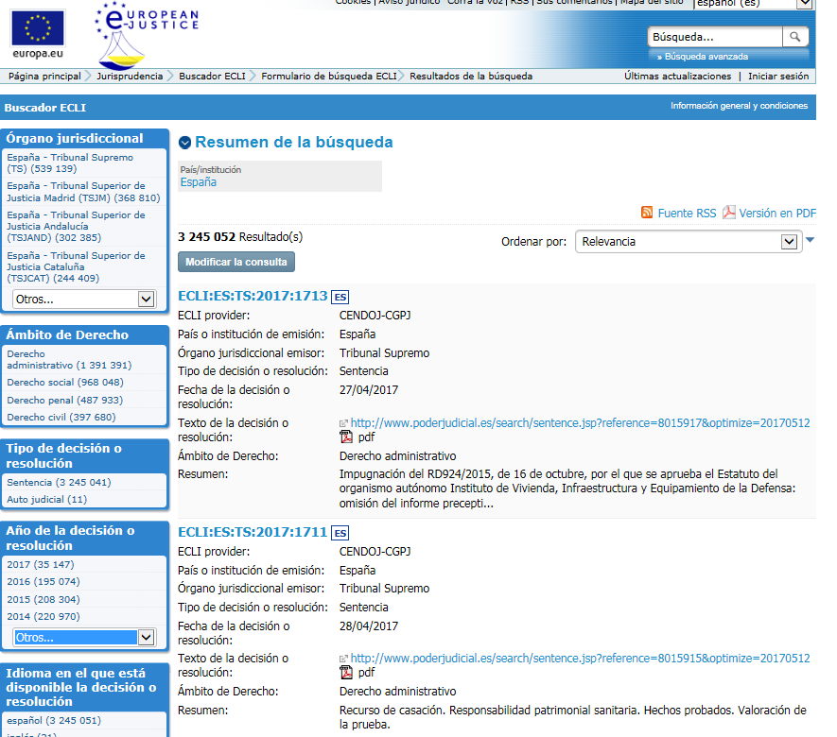
SITEMAP FILES
Start sending in: 2014
Resolutions DATA:
Since 1852
Until 2017
Weekly delivery:
1.245 eclis (on average)
More than 3.000.000 of ECLIS

Slide 6
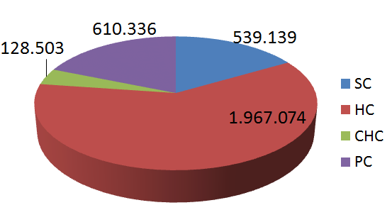
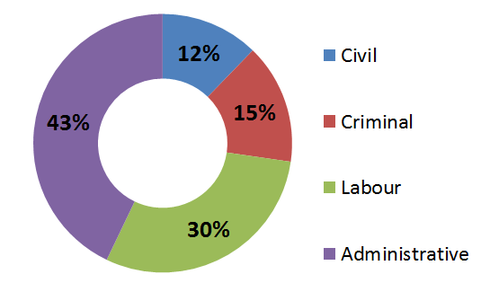
SITEMAP FILES
Supreme Court, High Courts, Central High Court & Provincial Courts
All regions from Spain
All branch of law

Slide 7
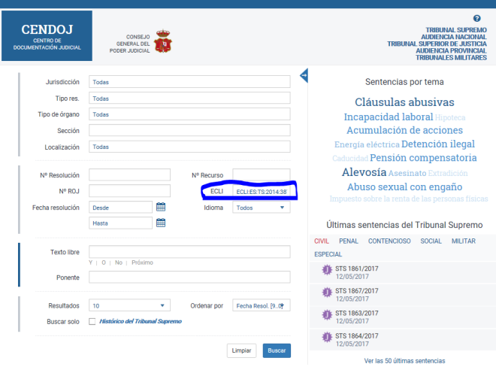
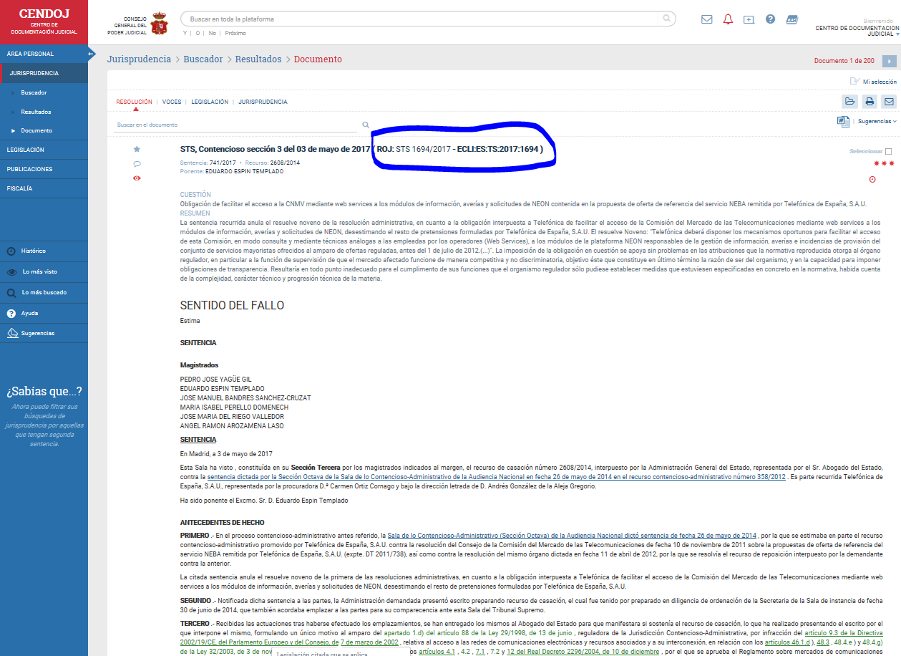
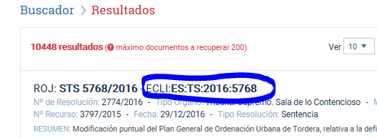
PROMOTING ECLI: INTERNAL promotion
PUBLIC WEBSITE
PRIVATE WEBSITE
Judges, prosecutors,..
Citizens
http://www.poderjudicial.es/search/indexAN.jsp
https://www3.poderjudicial.es/search/index.jsp

Slide 8
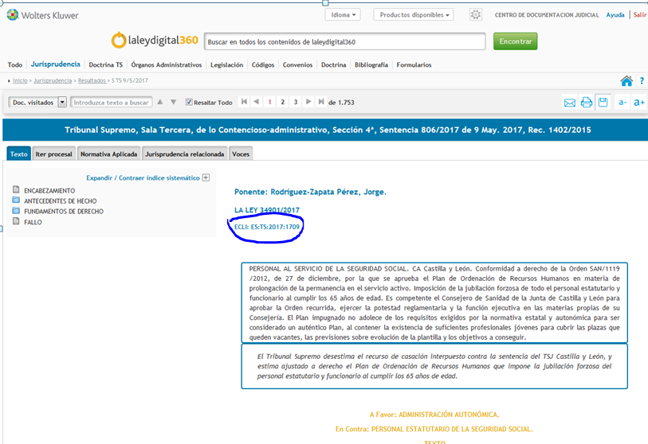
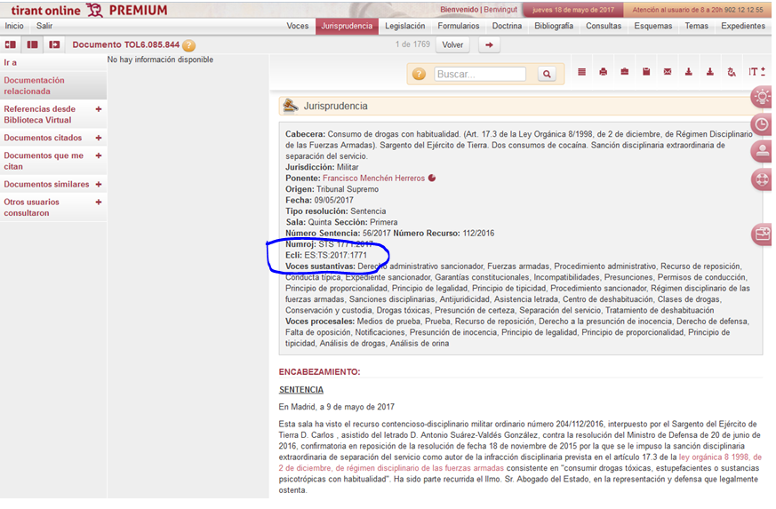
PROMOTING ECLI: EXTERNAL promotion
TO THE RE-USER, PUBLISHERS (30),..

Slide 9
HIGH USE
Citizens, lawyers,…
PUBLIC WEBSITE
More than 8.000.000 queries/year
http://www.poderjudicial.es/search/indexAN.jsp

Slide 10
HIGH USE
Judges & Senior judges
PRIVATE WEBSITE
More than 4.500.000 queries/year
http://www.poderjudicial.es/search/indexAN.jsp

Slide 11
VARIETY AND VOLUME
LEGAL INFORMATION
DOCTRINE and LEGAL PUBLICATIONS
CASE LAW
Other courts
Constitutional Court
CJEU
ECHR

Slide 13
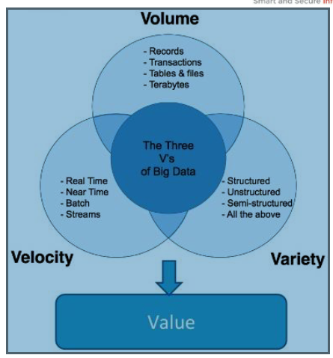
BIG DATA ANALYTICS
Big Data analytics refers to the process of collecting, organizing, and analyzing large data sets (BigData) to discover patterns and other useful information using statistical algorithms and artificial intelligence
Artificial Intelligence:
* Machine Learning (learning through examples)
* Deep learning (neural networks)

Slide 14
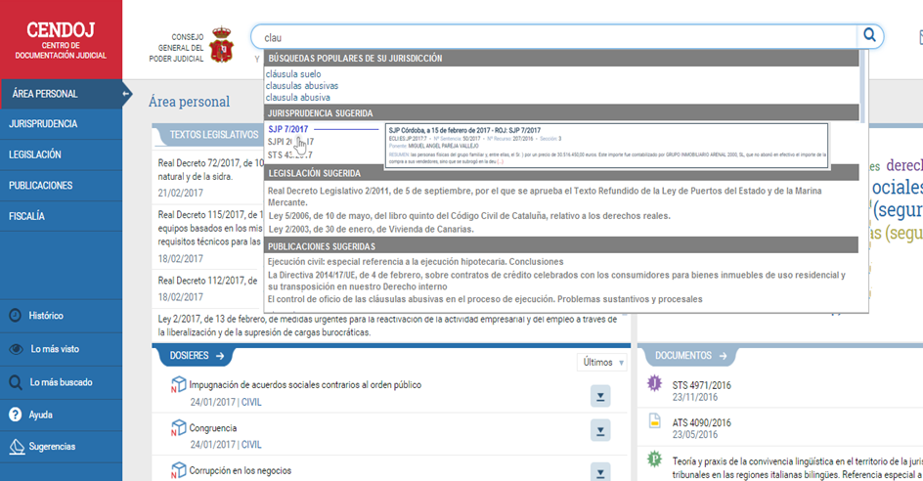
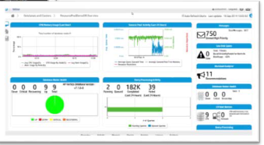
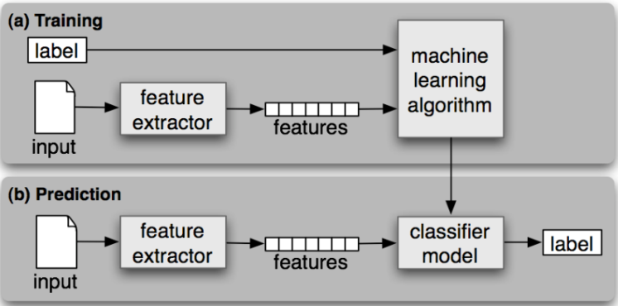
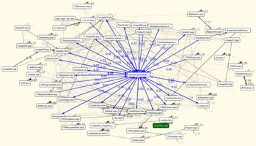
BIG DATA ANALYTICS : use cases
Search Engine: Predictive autocomplete
DWH: Datamart Queries
Resolutions classifier
Automated extraction of terminology in legal texts
* Public tenders to private enterprises
* Agreement with “SESIAD”, State Secretary of Digital Agenda, for the promotion of language technologies in the field of justice.

Slide 15
BIG DATA ANALYTICS : use cases
Search Engine: Autocomplete predictive
Queries
SUMMARY
Resolutions
Legal Information
Publications
Documents of the Office of the Prosecutor

Slide 16
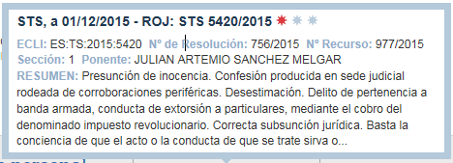
BIG DATA ANALYTICS : use cases
Search Engine: Predictive autocomplete
FAISAN
Crime of belonging to armed group

Slide 17
Thank you
This presentation has been produced with the financial support of the Justice Programme of the European Union. The contents of this publication are the sole responsibility of the partners of the BO-ECLI project and can in no way be taken to reflect the views of the European Commission.
This project is co-funded by
the European Union

